Slide 1
Algorithms for adjusting parameters of combination of acyclic adjacency graphs in the problems of texture image processing
05.13.17 – Theoretical foundations of information
Dissertation for the degree of
Candidate of technical sciences
Postgraduate student of TSU Sang D.V. Scientific advisor: Dr. Sc., prof. Dvoenko S.D.
Moscow 2013

Slide 2
General characteristics of the work. The topicality of the work
Nowadays the problems of computer data processing are topical. In these problems observations are related in a single array, on elements of the array it is often necessary to make a coordinated decision with regard of adjacent elements
One of such problems is that of raster texture image processing for the purpose of their segmentation by types of raster textures, for example, the processing of cosmic aerial photographs, two-dimensional scenes, etc.
The interrelations between the array elements are represented by an adjacency graph
Any attempts to reduce the complexity of algorithms while maintaining an acceptable quality of the gained result are topical.
In linearly ordered arrays the adjacency graph is a chain. That adjacency allows us to organize the efficient processing of data arrays based on popular approaches such as dynamic programming method and Markov chain theory

Slide 3
General characteristics of the work. The topicality of the work
The linear Markov models controlling the change of hidden classes of recognized objects are proved to be extremely efficient
But for arbitrary adjacency graphs with cycles the segmentation problem is complicated. In particular, the adjacency graph for raster images is a lattice that contains cycles and is not an acyclic one. In these conditions the use of Markov models leads to time-consuming algorithms, and the processing problem (segmentation, recognition) is a NP-problem
In this work the proposed approach is based on the general idea of complexation of processing operators (algorithms) developed by the Zhuravlev’s scientific school
In particular, raster image processing in this work is based on the idea of replacing the arbitrary adjacency graphs by tree-like ones and linearly combining acyclic Markov models in order to get the best quality of the restoration of hidden classes

Slide 4
General characteristics of the work. The issue
In the proposed approach Markov parameters (transition matrix ) in acyclic models were previously suboptimal without tuning their values on the training set
The purpose of the work
Developing methods for the optimal tuning of acyclic Markov models in order to significantly improve the quality of solving recognition problems (segmentation of raster texture images)

Slide 5
Main research problems
Solving the problem of adjusting the diagonal element of transition matrix for an acyclic model, and developing algorithms for adjusting the diagonal element for a given acyclic adjacency graph
Studying the singular properties of the basic recognition algorithm (Dvoenko S.D., Kopilov A.B., Mottl V.V., 2001) at the limiting values of the diagonal element
Studying the properties of the previously proposed algorithm for adjusting weights (Dvoenko S.D., 2006) in the combination of acyclic adjacency graphs.
Solving the problem of simultaneously adjusting the diagonal element of transition matrix and weights of the acyclic adjacency graphs in their linear combination. Developing training algorithms based on the adjustment of parameters of the acyclic adjacency graph combination.
Experimentally studying the developed algorithms in the problem of raster texture image segmentation
Evaluating the quality of solving the recognition problem in interrelated data arrays and the statistical properties of decision rule based on the cross-validation method

Slide 6
Positions constituting the scientific newness and being carried out on the defense
Formulation of the problem of searching for the optimal value of the diagonal element of transition matrix of a Markov chain corresponding to a particular model of the one-sided Markov random field
Algorithms for adjusting the diagonal element for an acyclic adjacency graph
Algorithm for adjusting the single diagonal element and the weights of the linear combination for a given set of acyclic adjacency graphs
Algorithms for adjusting the diagonal elements and the weights of the linear combination for a given set of acyclic adjacency graphs (First and second scheme)
Interactive scheme for classical independent training on the user’s data which provides an acceptable quality of the initial solving
Heuristic scheme for updating a posteriori marginal distributions of hidden classes in order to improve the quality of solving segmentation problem

Slide 7
Approbation and application of the work
Approbation of the work
XIV Mathematical methods for Pattern Recognition, Suzdaly, 2009
VI master conference TSU, Tula, 2011
XXI International conference for students, postgraduate students and young scientists «Lomonosov 2012» , Moscow, 2012
IX Intellectualization of Information Processing, Montenegro, Budva city, 2012
GraphiCon 2012, Moscow, 2012
Application of the work
Research results are applied in Vietnam companies «FPT Software JSC», «FTS company» for processing real images.

Slide 8
Publications
1. Dvoenko S.D., Savenkov D.S., Sang D.V. Acyclic Markov Models in Analysis of Interrelated Data Array // Izvestiya TSU. Natural Sciences. 2010. Vol. 2. P. 173-185.
2. Dvoenko S.D., Sang D.V. Algorithms for Adjusting Parameters of a Tree-like Markov Random Field in the Problem of Raster Texture Image Recognition // Izvestiya TSU. Natural Sciences. 2012. Vol. 1. P. 98-109.
3. Dvoenko S.D., Sang D.V. Algorithms for Adjusting Parameters of Combination of Acyclic Adjacency Graphs in the Problem of Texture Image Recognition // Izvestiya TSU. Technical Sciences. 2012. Vol. 3. P. 253-262.
4. Dvoenko S.D., Savenkov D.S., Sang D.V. Combination of Acyclic Adjacency Graphs in the Problem of Markov Random Field Recognition // Proc. XIV conference «Mathematical methods for Pattern Recognition». – Moscow: Maks Press, 2009. P. 441–444.
5. Dvoenko S.D., Sang D.V. Parametric Acyclic Markov Models in the problem of Interrelated Object Recognition // Proc. IX International Conference «Intellectualization of Information Processing». – Moscow: Torus Press, 2012. P. 18–21.
6. Dvoenko S.D., Sang D.V. Raster Texture Image Recognition based on Parametric Acyclic Markov Fields // Proc. XXII International conference in Computer Graphic and Vision «GraphiCon-2012». – Moscow: Maks Press, 2012. P. 139–143.
7. Sang D.V. Algorithms for Adjusting Parameters of Combination of Acyclic Adjacency Graphs in the Problem of Texture Image Recognition // Proc. XXI conference «Lomonosov – 2012» Section «Computational mathematics and cybernetics». – Moscow: Maks Press, 2012. P. 20–21.

Slide 9
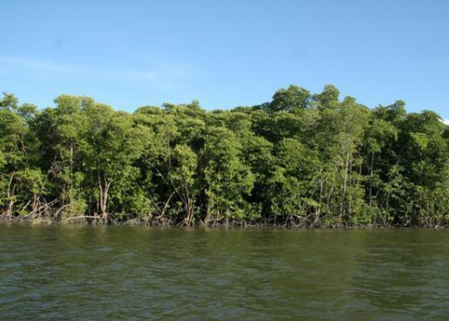
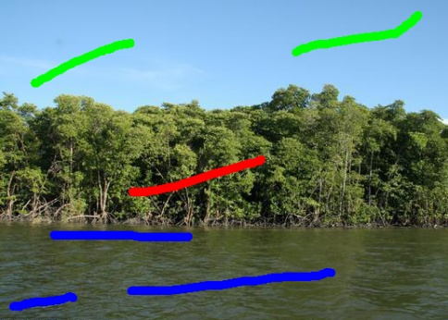
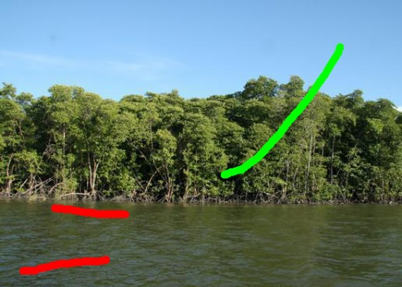
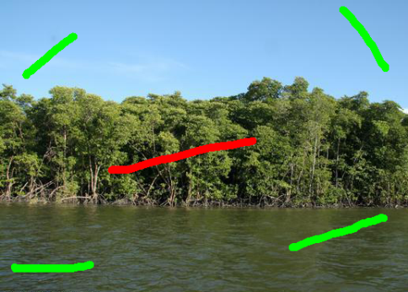
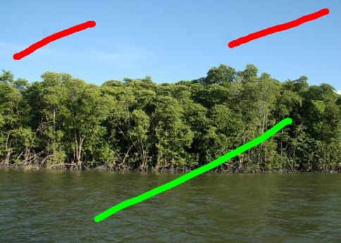
Real image processing

Slide 10
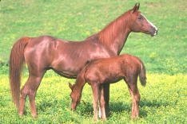
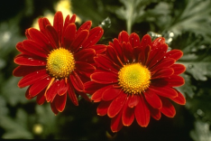
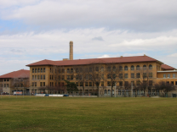
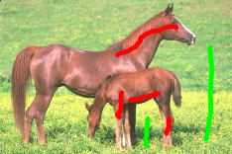
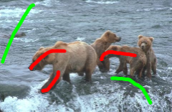
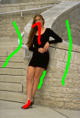
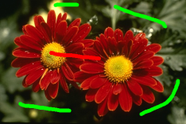
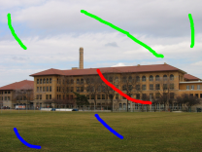
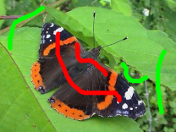
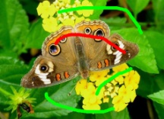
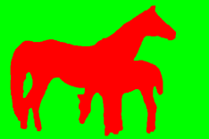
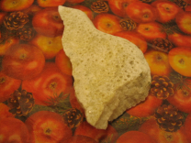
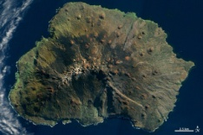
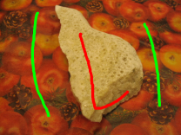
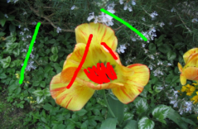
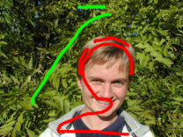
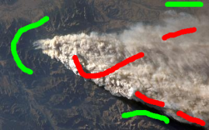
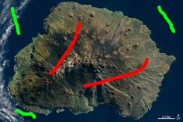
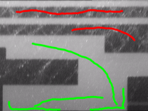
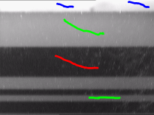
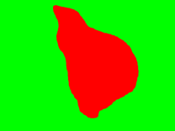
Real image processing
Dataset BSDS500
Dataset «FTS Corp»
Horses (481х321)
Bears (481х312)
Girl (321х473)
Flowers (481х321)
School (640х480)
Butterfly (800х600)
Butterfly (500х360)
Dataset of developers TRWS
Dataset «FPT Software»
White-black images
Sponge (640х480)
Flower (640х480)
Person (640х480)
Smoke (400х248)
Island (550х367)
768x576
768x576

Slide 11
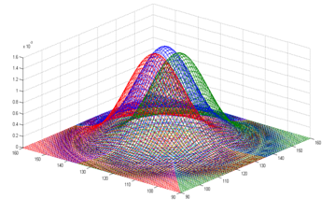
Experiments. Simulated texture images
Image № 1 (201×201)
Feature space
Given segmentations of 100 simulated images

Slide 12
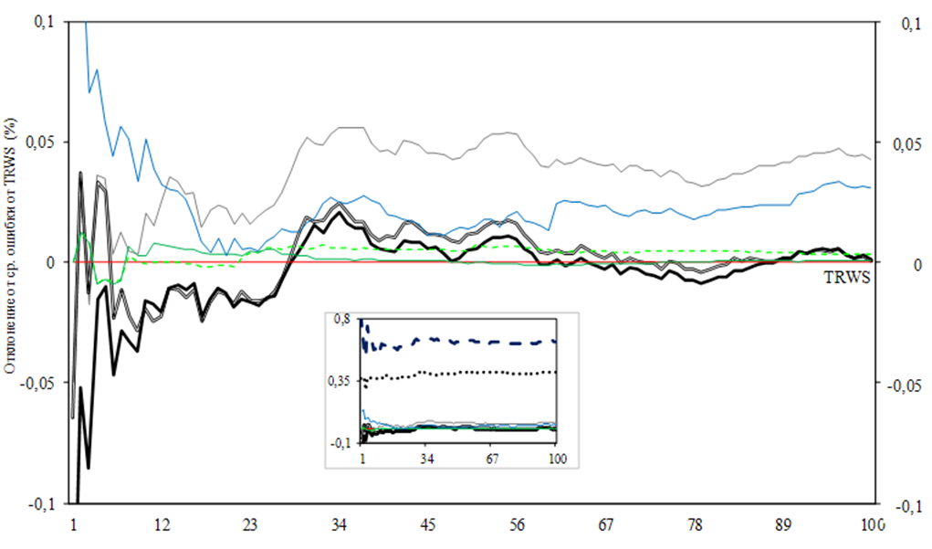
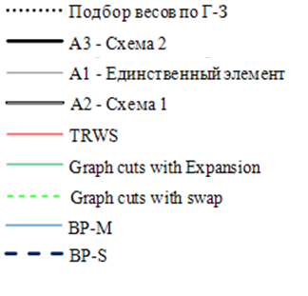
Comparing developed algorithms with other popular recognition algorithms
Deviation of error lines
Comparing developed algorithms with ТRWS (Tree Re-Weighted Message Passing Sequential)
Indicator | Algorithm А1 – Unique diagonal element | Algorithm А2 – First scheme | Algorithm А3 – Second scheme
Number of cases (better than TRWS) | 35 | 55 | 50
Number of errors (more than TRWS) | 1721 | 17 | 43

Slide 13
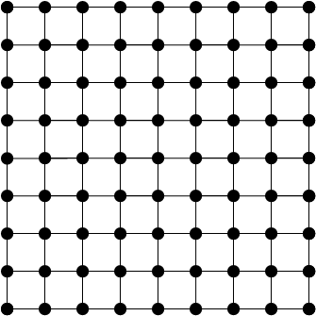
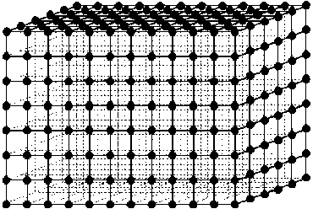
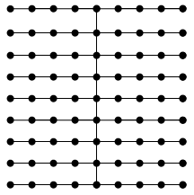
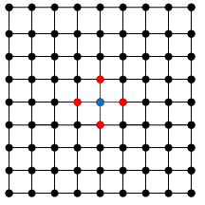
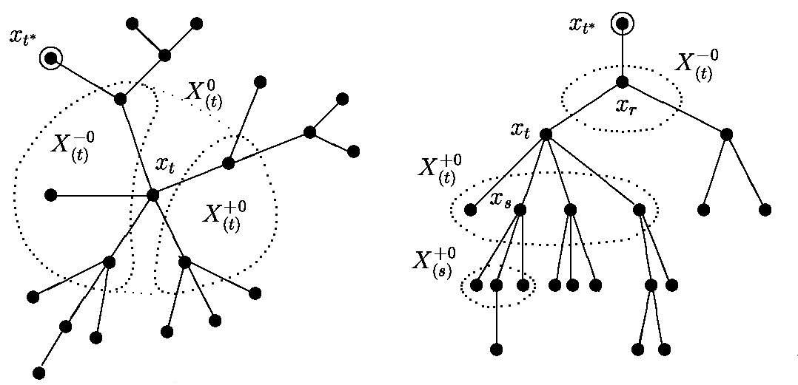
Problem of interrelated data array recognition
Example of adjacency graph
Acyclic adjacency graph and Markov property of field
Chain
Lattice
Data cube
Example of acyclic
adjacency graph
Markov property of random field for lattice
Basic algorithm for recognition
Particular model of Markov random field (MRF)
1
3
2
One-sided MRF is homogeneous, ergodic and reversible.
MRF is specified by an symmetric and twice stochastic matrix:
was previously specified heuristically, for instance,
1. Determine a prior marginal distributions of hidden classes
2. Filtration
3. Interpolation

Slide 14
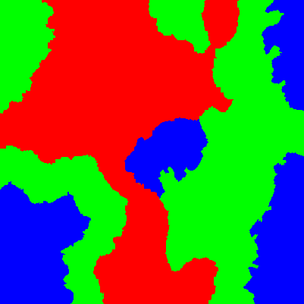
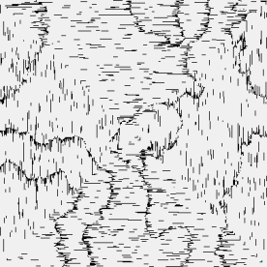
Combination of acyclic adjacency graphs
Simulated image(401х401)
Independent recognition (49,04%)
...
where – number of graphs,
– weight of -th graph .

Slide 15
Parameters of combination of acyclic adjacency graphs. Natural and structural model parameters
Parameters of combination of acyclic adjacency graphs: graph weights and diagonal element of transition matrix
Model parameters may be natural or structural. But sometimes the difference between them is quite unclear
Graph weights and diagonal element can be treated as either natural or structural
In this work:
- Graph weights – natural; Diagonal element – structural
- «Hybrid» approach: Develop algorithms in which the diagonal element is treated as natural parameter, but the quality of decision rule is evaluated by the cross-validation scheme used in tuning structural parameters

Slide 16
Algorithms for adjusting parameters of combination of acyclic adjacency graphs

Slide 17
Algorithms for adjusting parameters of combination of acyclic adjacency graphs

Slide 18
Algorithms for adjusting parameters of combination of acyclic adjacency graphs

Slide 19
Estimation of Markov parameter based on maximum likelihood
If the realization of hidden field is known:
Then:
If the realization of hidden field is partially known:
Iterative solving of two problems:
- with fixed and solve the problem
- with fixed solve the problem

Slide 20
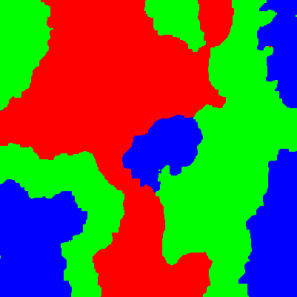
Parameters of algorithm tuning and example of simulated image processing
Example of algorithm tuning on some simulated images
Image | А1 |  | А2 |  | А3
 | weights | q | weights | q | weights | q
1 | 0,04282 0,20338 0,24000 0,25690 0,25690 | 0,86 | 0,03947 0,23684 0,25000 0,23684 0,23684 | 0,90 0,89 0,91 0,90 0,89 | 0,02000 0,09287 0,36836 0,25939 0,25939 | 0,75 0,93 0,92 0,89 0,89
52 | 0,16486 0,23356 0,23356 0,25000 0,11803 | 0,89 | 0,46511 0,13000 0,14111 0,14111 0,12267 | 0,37 0,61 0,90 0,92 0,82 | 0,15000 0,21329 0,21329 0,21329 0,21012 | 0,36 0,89 0,89 0,89 0,94
Example of simulated image processing
Simulated image
Exact segmentation
Result of processing
Error of processing

Slide 21
Cross-validation scheme. Estimation of recognition error on the general set
…
100 images – initial set
Test set
Training set
TestErr₁
…
TestErr₂
w₁
q₁
…
ValErr₁
…
TestErr₁₀₀
w₂
q₂
…
ValErr₂
w₃
q₃
…
ValErr₃
………..
…
w₉₈
q₉₈
ValErr₉₈
…
w₉₉
q₉₉
ValErr₉₉
Test image
Training image
Valid image

Slide 22
Cross-validation scheme. Comparison of general errors
General error gained by different algorithms for adjusting parameters of combination of acyclic adjacency graphs

Slide 23
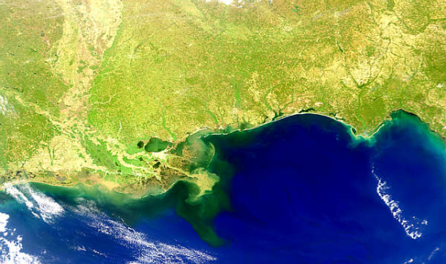
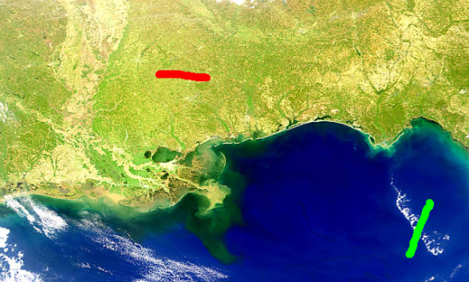
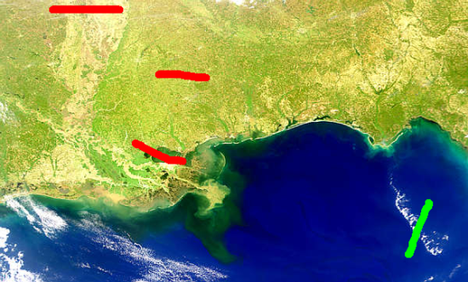
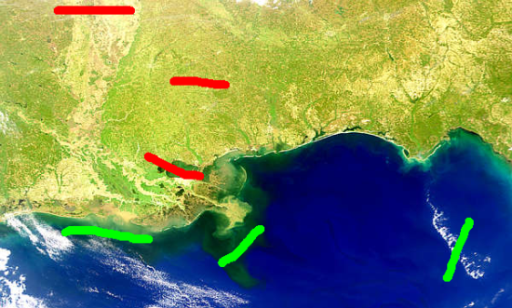
Real image processing. Interactive scheme of classical independent training based on the user’s data
Initial image
Independent training
Stop condition: There is no undesirable region.
Stop condition may be unreachable if the classes contain quite alike texture regions

Slide 24
Real image processing. Heuristic scheme for updating a posteriori marginal distributions of hidden classes
Problem:
- The graph combination efficiently removes small undesirable regions only if the distributions of classes are fuzzy
- Increase of iteration number stabilizes data, turning a posteriori marginal probabilities into zeros and ones
Update parameters:
- Update coefficient:
- Update threshold:
Update principle:
Update a posteriori distributions of pixels for which the maximal probability is more than the update threshold as follows:

Slide 25
Main results of the work
The problem of adjusting the diagonal element of transition matrix for an acyclic model, and developing algorithms for selecting the diagonal element for a given acyclic adjacency graph is solved
The singular properties of the basic recognition algorithm at the limiting values of the diagonal element are proved
The properties of the previously proposed algorithm for adjusting weights in the combination of acyclic adjacency graphs are studied
The problem of simultaneously adjusting the diagonal element of transition matrix and weights of the acyclic adjacency graphs in their linear combination is solved
The experimental study of the developed algorithms in the problem of raster texture image segmentation is done
The evaluation of the quality of solving the recognition problem in interrelated data arrays and the statistical properties of decision rule based on the cross-validation method is done

