Slide 1
Cotutelle PhD thesis
Fuzzy Multilevel Graph Embedding for Recognition, Indexing and Retrieval of Graphic Document Images
Directors of thesis
Dr. Jean-Yves RAMEL
Professor
University of Tours, France
Dr. Josep LLADOS
Professor
UAB, Spain
Co-supervisor
Dr. Thierry BROUARD
Assistant Professor
University of Tours, France
presented by
Muhammad Muzzamil LUQMAN
mluqman@{univ-tours.fr, cvc.uab.es}
Friday, 2nd of March 2012

Slide 2
Higher Education Commission Pakistan
www.hec.gov.pk

Slide 3
3
Objectives of thesis
Problematic
Lack of efficient computational tools for graph based structural pattern recognition
Proposed solution
Transform graphs into numeric feature vectors and exploit computational strengths of state of the art statistical pattern recognition

Slide 4
4
Outline of presentation
Introduction
Fuzzy Multilevel Graph Embedding (FMGE)
Automatic indexing of graph repositories for graph retrieval and subgraph spotting
Conclusions and future research challenges

Slide 5
5
Introduction
Introduction
Structural and statistical pattern recognition
Graph embedding
State of the art on explicit graph embedding
Limitations of existing methods
Fuzzy Multilevel Graph Embedding (FMGE)
Automatic indexing of graph repositories for graph retrieval and subgraph spotting
Conclusions and future research challenges

Slide 6
Introduction
Fuzzy Multilevel Graph Embedding
Automatic Indexing of graph repositories
Conclusions and future research challenges
o o o o
6
Structural and statistical PR
Pattern Recognition
Structural | Statistical
Data structure
Representational strength
Fixed dimensionality
Sensitivity to noise
Efficient computational tools
symbolic data structure | numeric feature vector
Yes | No
No | Yes
Yes | No
No | Yes

Slide 7
Introduction
Fuzzy Multilevel Graph Embedding
Automatic Indexing of graph repositories
Conclusions and future research challenges
o o o o
7
Graph matching to graph embedding
Graph matching and graph isomorphism
Graph edit distance
Graph embedding

Slide 8
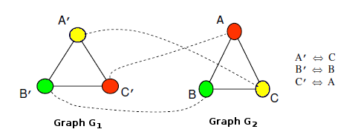
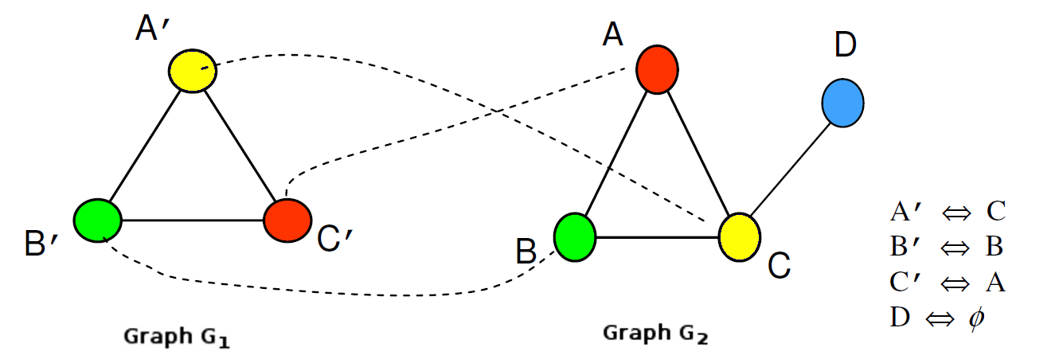
Introduction
Fuzzy Multilevel Graph Embedding
Automatic Indexing of graph repositories
Conclusions and future research challenges
o o o o
8
Graph matching to graph embedding
Graph matching and graph isomorphism
[Messmer, 1995] [Sonbaty and Ismail, 1998]
Graph edit distance
Graph embedding

Slide 9
Introduction
Fuzzy Multilevel Graph Embedding
Automatic Indexing of graph repositories
Conclusions and future research challenges
o o o o
9
Graph matching to graph embedding
Graph matching and graph isomorphism
[Messmer, 1995] [Sonbaty and Ismail, 1998]
Graph edit distance
[Bunke and Shearer, 1998] [Neuhaus and Bunke, 2006]
Graph embedding
Graph matching and graph isomorphism
[Messmer, 1995] [Sonbaty and Ismail, 1998]
Graph edit distance
[Bunke and Shearer, 1998] [Neuhaus and Bunke, 2006]
Graph embedding

Slide 10
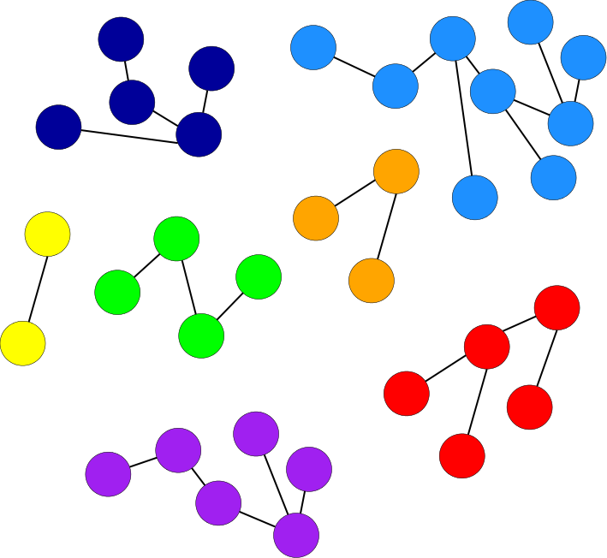
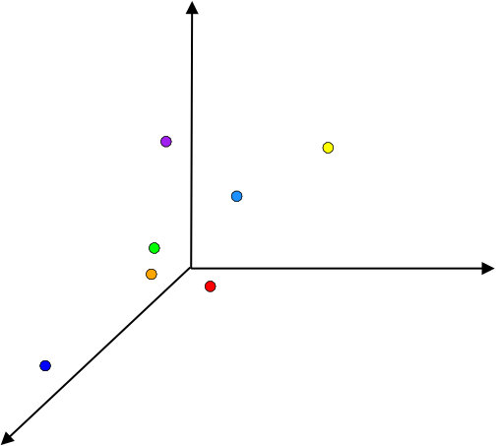
Introduction
Fuzzy Multilevel Graph Embedding
Automatic Indexing of graph repositories
Conclusions and future research challenges
o o o o
10
Graph embedding (GEM)

Slide 11
Introduction
Fuzzy Multilevel Graph Embedding
Automatic Indexing of graph repositories
Conclusions and future research challenges
o o o o
11
Graph embedding (GEM)
Structutal PR
Expressive,
convenient,
powerful but
computationally expensive representations
Statistical PR
Mathematically sound,
mature,
less expensive and computationally efficient models
Graph embedding

Slide 12
Introduction
Fuzzy Multilevel Graph Embedding
Automatic Indexing of graph repositories
Conclusions and future research challenges
o o o o
12
Explicit and implicit GEM
Explicit GEM
embeds each input graph into a numeric feature vector
provides more useful methods of GEM for PR
can be employed in a standard dot product for defining an implicit graph embedding function
Implicit GEM
computes scalar product of two graphs in an implicitly existing vector space, by using graph kernels
does not permit all the operations that could be defined on vector spaces

Slide 13
Introduction
Fuzzy Multilevel Graph Embedding
Automatic Indexing of graph repositories
Conclusions and future research challenges
o o o o
13
State of the art on explicit GEM
Graph probing based methods
Spectral based graph embedding
Dissimilarity based graph embedding

Slide 14
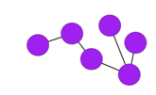
Introduction
Fuzzy Multilevel Graph Embedding
Automatic Indexing of graph repositories
Conclusions and future research challenges
o o o o
14
State of the art on explicit GEM
Graph probing based methods
[Wiener, 1947] [Papadopoulos et al., 1999] [Gibert et al., 2011] [Sidere, 2012]
Spectral based graph embedding
Dissimilarity based graph embedding
number of nodes = 6
number of edges = 5
etc.
v = 6,5, …

Slide 15
Introduction
Fuzzy Multilevel Graph Embedding
Automatic Indexing of graph repositories
Conclusions and future research challenges
o o o o
15
State of the art on explicit GEM
Graph probing based methods
[Wiener, 1947] [Papadopoulos et al., 1999] [Gibert et al., 2011] [Sidere, 2012]
Spectral based graph embedding
[Harchaoui, 2007] [Luo et al., 2003] [Robleskelly and Hancock, 2007]
Dissimilarity based graph embedding
 | 1
1 |  | 1
 | 1 |  | 1
 |  | 1 |  | 1 | 1
 |  |  | 1
 |  |  | 1
Spectral graph theory employing the
adjacency and Laplacien matrices
Eigen values and Eigen vectors
PCA, ICA, MDS

Slide 16
Introduction
Fuzzy Multilevel Graph Embedding
Automatic Indexing of graph repositories
Conclusions and future research challenges
o o o o
16
State of the art on explicit GEM
Graph probing based methods
[Wiener, 1947] [Papadopoulos et al., 1999] [Gibert et al., 2011] [Sidere, 2012]
Spectral based graph embedding
[Harchaoui, 2007] [Luo et al., 2003] [Robleskelly and Hancock, 2007]
Dissimilarity based graph embedding
[Pekalska et al., 2005] [Ferrer et al., 2008] [Riesen, 2010] [Bunke et al., 2011]
Prototype graphs
P1
P2
P3
…
g
v = d(g, P1), d(g, P2), …

Slide 17
Introduction
Fuzzy Multilevel Graph Embedding
Automatic Indexing of graph repositories
Conclusions and future research challenges
o o o o
17
Limitations of existing methods
Not many methods for both directed and undirected attributed graphs
No method explicitly addresses noise sensitivity of graphs
Expensive deployment to other application domains
Time complexity
Loss of topological information
Loss of matching between nodes
No graph embedding based solution to answer high level semantic problems for graphs

Slide 18
18
Fuzzy Multilevel Graph Embedding
Introduction
Fuzzy Multilevel Graph Embedding (FMGE)
Method
Experimental evaluation
Application to symbol recognition
Discussion
Automatic indexing of graph repositories for graph retrieval and subgraph spotting
Conclusions and future research challenges

Slide 19
Introduction
Fuzzy Multilevel Graph Embedding
Automatic Indexing of graph repositories
Conclusions and future research challenges
o o o o
19
FMGE
Fuzzy Multilevel Graph Embedding (FMGE)
Graph probing based explicit graph embedding method

Slide 20
Introduction
Fuzzy Multilevel Graph Embedding
Automatic Indexing of graph repositories
Conclusions and future research challenges
o o o o
20
FMGE
Multilevel analysis of graph
Graph Level Information
[macro details]
Structural Level Information
[intermediate details]
Elementary Level Information
[micro details]
Graph order
Graph size
Node degree
Homogeneity of subgraphs in graph
Node attributes
Edge attributes

Slide 21
Introduction
Fuzzy Multilevel Graph Embedding
Automatic Indexing of graph repositories
Conclusions and future research challenges
o o o o
21
FMGE
Numeric feature vector embeds a graph, encoding:
Numeric information by fuzzy histograms
Symbolic information by crisp histograms

Slide 22
Introduction
Fuzzy Multilevel Graph Embedding
Automatic Indexing of graph repositories
Conclusions and future research challenges
o o o o
22
FMGE
Input : Collection of attributed graphs
Output : Equal-size numeric feature vector for each input graph

Slide 23
Introduction
Fuzzy Multilevel Graph Embedding
Automatic Indexing of graph repositories
Conclusions and future research challenges
o o o o
23
Fuzzy Structural Multilevel Feature Vector
Graph Level Information
[macro details]
Structural Level Information
[intermediate details]
Elementary Level Information
[micro details]
Graph order | Graph size
…
Fuzzy histogram of node degrees | Fuzzy histograms of numeric resemblance attributes | Crisp histograms of symbolic resemblance attributes
…
Fuzzy histograms of numeric node attributes | Crisp histograms of symbolic node attributes | Fuzzy histograms of numeric edge attributes | Crisp histograms of symbolic edge attributes

Slide 24
Introduction
Fuzzy Multilevel Graph Embedding
Automatic Indexing of graph repositories
Conclusions and future research challenges
o o o o
24
Homogeneity of subgraphs in a graph
Node-resemblance for an edge
Edge-resemblance for a node

Slide 25
Introduction
Fuzzy Multilevel Graph Embedding
Automatic Indexing of graph repositories
Conclusions and future research challenges
o o o o
25
Homogeneity of subgraphs in a graph
Node-resemblance for an edge
Edge-resemblance for a node
a₁
b₁
a
b
a₂
b₂

Slide 26
Introduction
Fuzzy Multilevel Graph Embedding
Automatic Indexing of graph repositories
Conclusions and future research challenges
o o o o
26
Homogeneity of subgraphs in a graph
Node-resemblance for an edge
Edge-resemblance for a node
a₃
b₃
a₁
b₁
a
b
a₂
b₂

Slide 27
Introduction
Fuzzy Multilevel Graph Embedding
Automatic Indexing of graph repositories
Conclusions and future research challenges
o o o o
27
FMGE
Unsupervised learning phase
Graph embedding phase

Slide 28
Introduction
Fuzzy Multilevel Graph Embedding
Automatic Indexing of graph repositories
Conclusions and future research challenges
o o o o
28
Unsupervised learning phase of FMGE

Slide 29
Introduction
Fuzzy Multilevel Graph Embedding
Automatic Indexing of graph repositories
Conclusions and future research challenges
o o o o
29
Unsupervised learning phase of FMGE
2 3 4 5 6 7 8 9
First fuzzy interval (-∞, -∞, …, …)
Last fuzzy interval (…, …, ∞, ∞)

Slide 30
Introduction
Fuzzy Multilevel Graph Embedding
Automatic Indexing of graph repositories
Conclusions and future research challenges
o o o o
30
Graph embedding phase of FMGE
Numeric information embedded by fuzzy histograms
Symbolic information embedded by crisp histograms

Slide 31
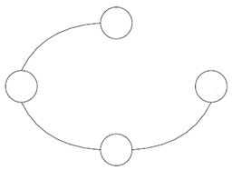
Introduction
Fuzzy Multilevel Graph Embedding
Automatic Indexing of graph repositories
Conclusions and future research challenges
o o o o
31
Example - FMGE
r_RL: *
r_Angle: *
RL : 1
Angle: B
L: 1
1
r_L: 1
r_NodeDegree:0.5
1
r_RL: *
r_Angle: *
2
L: 1
L: 0.5
4
2
4
r_RL: 1
r_Angle: 1
3
RL : 1
Angle: B
3
RL : 0.5
Angle: B
r_L: 1
r_NodeDegree:1
L: 1
r_L: 0.5
r_NodeDegree: 0.5
r_RL: 0.5
r_Angle: 1

Slide 32
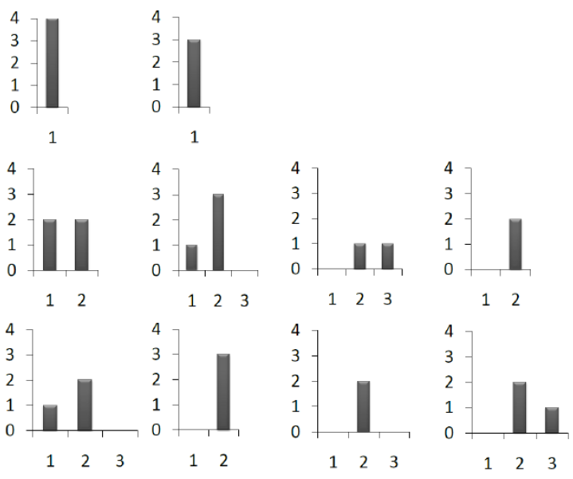
Introduction
Fuzzy Multilevel Graph Embedding
Automatic Indexing of graph repositories
Conclusions and future research challenges
o o o o
32
Example - FMGE
r_RL: *
r_Angle: *
RL : 1
Angle: B
L: 1
r_L: 1
r_NodeDegree:0.5
1
r_RL: *
r_Angle: *
L: 1
L: 0.5
r_RL: 1
r_Angle: 1
2
4
RL : 1
Angle: B
3
RL : 0.5
Angle: B
r_L: 1
r_NodeDegree:1
L: 1
r_L: 0.5
r_NodeDegree: 0.5
r_RL: 0.5
r_Angle: 1
FSMFV: 4,3,2,2,1,3,0,0,1,1,0,2,1,2,0,0,3,0,2,0,0,2,1
Node degree: [-∞,-∞,1,2] and [1,2,∞,∞]
Attributes {L,RL}: [-∞,-∞,0.5,1], [0.5,1,1.5,2] and [1.5,2, ∞,∞]
r_Angle: [-∞,-∞,0,1] and [0,1, ∞,∞]
Resemblance attributes: [-∞,-∞,0.25,0.5], [0.25,0.5,0.75,1.0] and [0.75,1.0, ∞,∞,]
The symbolic edge attribute Angle has two possible labels

Slide 33
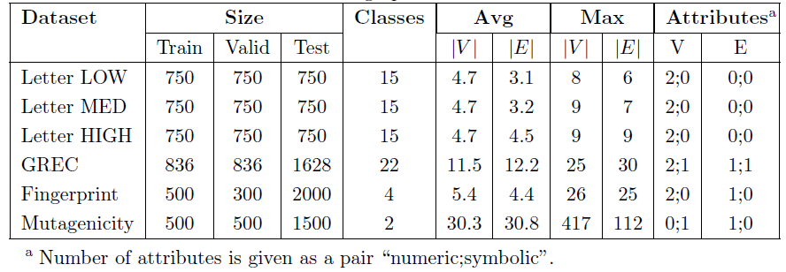
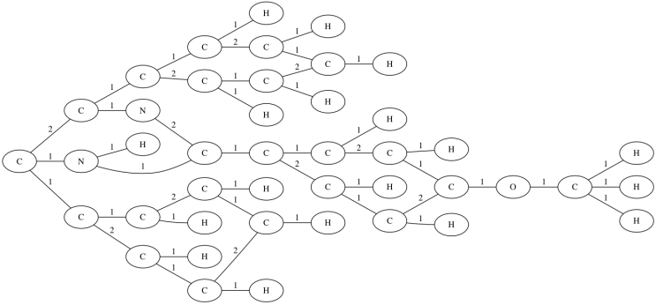
Introduction
Fuzzy Multilevel Graph Embedding
Automatic Indexing of graph repositories
Conclusions and future research challenges
o o o o
33
Experimental evaluation of FMGE
IAM graph database
Graph classification experimentations
Graph clustering experimentations

Slide 34
Introduction
Fuzzy Multilevel Graph Embedding
Automatic Indexing of graph repositories
Conclusions and future research challenges
o o o o
34
Graph classification experimentations
Supervised machine learning framework for experimentation, employing the training, validation and test sets
1-NN classifier with Euclidean distance.
Equal-spaced crisp discretization and the number of fuzzy intervals empirically selected on validation dataset

Slide 35
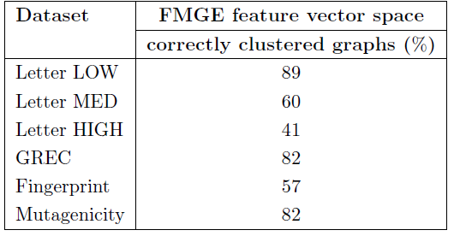
Introduction
Fuzzy Multilevel Graph Embedding
Automatic Indexing of graph repositories
Conclusions and future research challenges
o o o o
35
Graph clustering experimentations
Merged training, validation and test sets
K-means clustering with random non-deterministic initialization
The measure of quality of K-means clustering w.r.t. the ground truth : ratio of correctly clustered graphs to the graphs in the dataset
Equal-frequency crisp discretization for automatically selecting the best number of fuzzy intervals

Slide 36
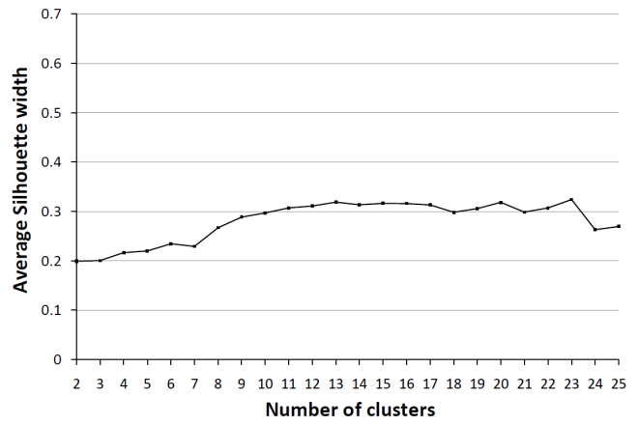
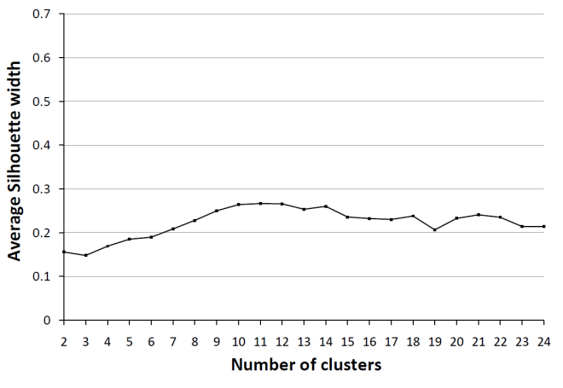
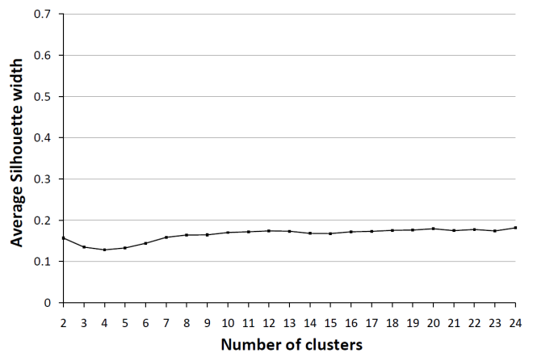
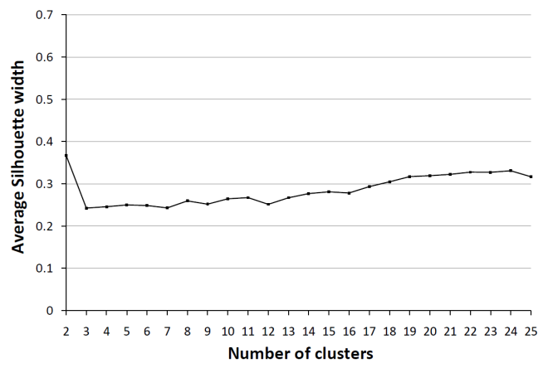
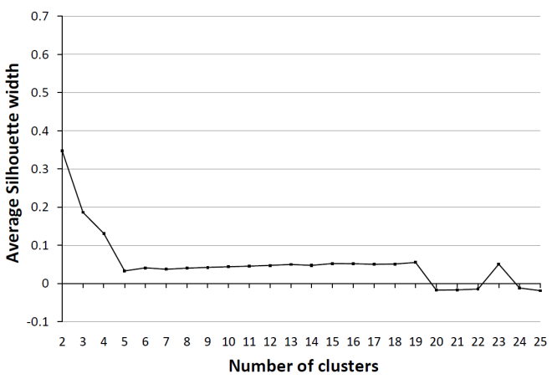
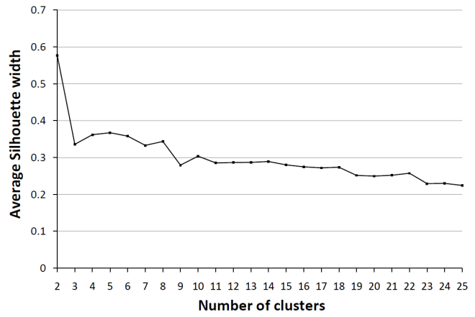
Introduction
Fuzzy Multilevel Graph Embedding
Automatic Indexing of graph repositories
Conclusions and future research challenges
o o o o
36
Graph clustering experimentations
Letter-LOW, Letter-MED and Letter-HIGH
GREC, Fingerprint and Mutagenicity
The average Silhouette width ranges between [-1, 1]. The closer it is to 1, the better the is the clustering quality.

Slide 37
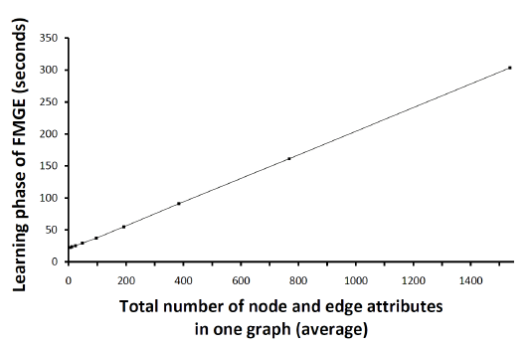
Introduction
Fuzzy Multilevel Graph Embedding
Automatic Indexing of graph repositories
Conclusions and future research challenges
o o o o
37
Time complexity of FMGE
Unsupervised learning phase is performed off-line and is linear to:
Number of node and edge attributes
Size of graphs
Graph embedding phase is performed on-line

Slide 38
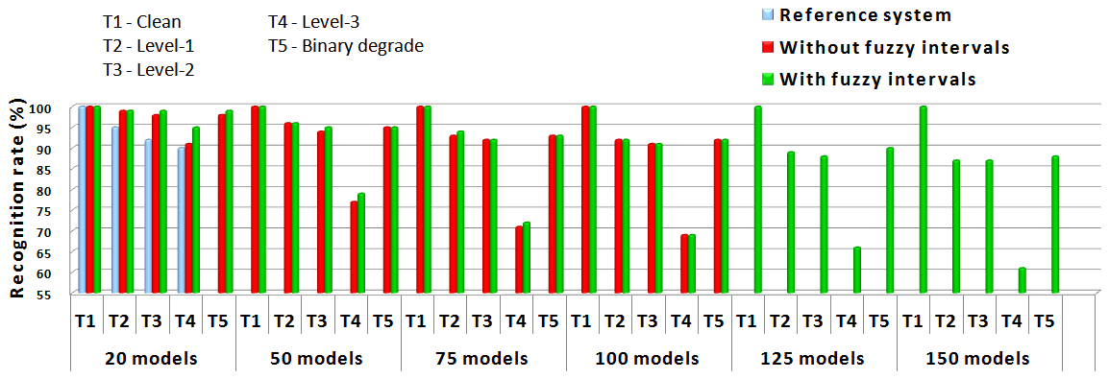
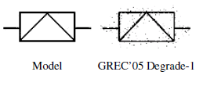
Introduction
Fuzzy Multilevel Graph Embedding
Automatic Indexing of graph repositories
Conclusions and future research challenges
o o o o
38
Application to symbol recognition
2D linear model symbols from GREC databases
Learning on clean symbols and testing against noisy and deformed symbols

Slide 39
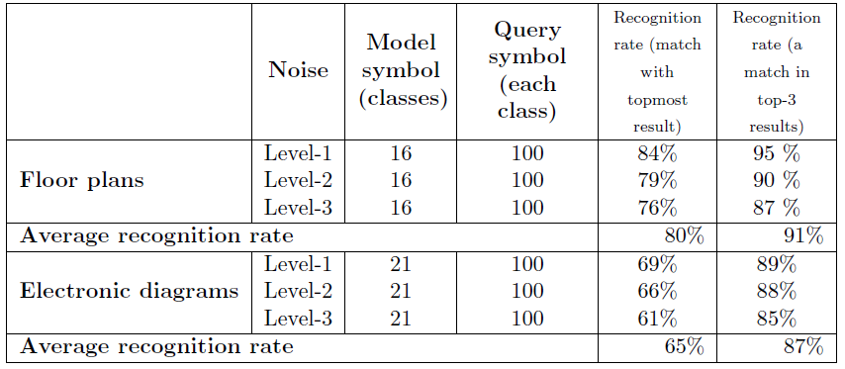
Introduction
Fuzzy Multilevel Graph Embedding
Automatic Indexing of graph repositories
Conclusions and future research challenges
o o o o
39
Application to symbol recognition
SESYD dataset
Learning on clean symbols and testing against noisy symbols

Slide 40
Introduction
Fuzzy Multilevel Graph Embedding
Automatic Indexing of graph repositories
Conclusions and future research challenges
o o o o
40
Summary and discussion - FMGE
Not many methods for both directed and undirected attributed graphs
FMGE: Directed and undirected graphs with many numeric as well
as symbolic attributes on both nodes and edges
No method explicitly addresses noise sensitivity of graphs
FMGE: Fuzzy overlapping intervals
Expensive deployment to other application domains
FMGE: Unsupervised learning abilities

Slide 41
Introduction
Fuzzy Multilevel Graph Embedding
Automatic Indexing of graph repositories
Conclusions and future research challenges
o o o o
41
Summary and discussion - FMGE
Time complexity
FMGE: Linear to number of attributes
Linear to size of graphs
Graph embedding performed on-line
Loss of topological information
FMGE: Multilevel information (global, topological and elementary)
Homogeneity of subgraphs in graph

Slide 42
Introduction
Fuzzy Multilevel Graph Embedding
Automatic Indexing of graph repositories
Conclusions and future research challenges
o o o o
42
Summary and discussion - FMGE
Loss of matching between nodes
No graph embedding based solution to answer high level semantic problems for graphs

Slide 43
43
Automatic indexing of graph repositories
Introduction
Fuzzy Multilevel Graph Embedding (FMGE)
Automatic indexing of graph repositories for graph retrieval and subgraph spotting
Method
Experimental evaluation - application to content spotting in graphic document image repositories
Discussion
Conclusions and future research challenges

Slide 44
Introduction
Fuzzy Multilevel Graph Embedding
Automatic Indexing of graph repositories
Conclusions and future research challenges
o o o
44
Subgraph spotting through explicit GEM
Bag of words inspired model for graphs
Index the graph repository by elementary subgraphs
Explicit GEM for exploiting computational strengths of state of the art machine learning, classification and clustering tools

Slide 45
Introduction
Fuzzy Multilevel Graph Embedding
Automatic Indexing of graph repositories
Conclusions and future research challenges
o o o
45
Subgraph spotting through explicit GEM
Unsupervised indexing phase
Graph retrieval and subgraph spotting phase

Slide 46
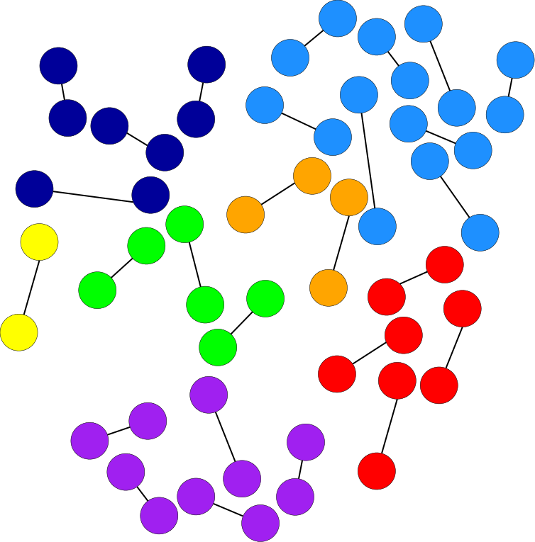
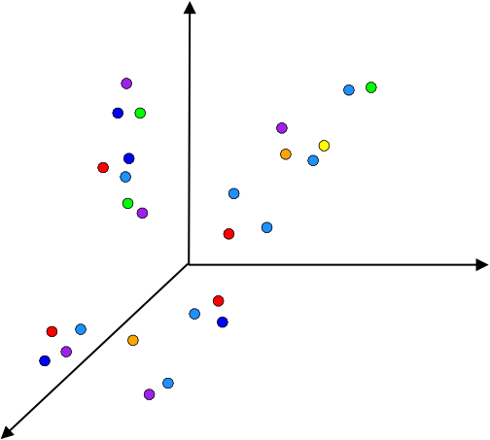
Introduction
Fuzzy Multilevel Graph Embedding
Automatic Indexing of graph repositories
Conclusions and future research challenges
o o o
46
Subgraph spotting through explicit GEM
Unsupervised indexing phase
Graph retrieval and subgraph spotting phase
φ
Resemblance attributes
Cliques of order-2
FSMFVs

Slide 47
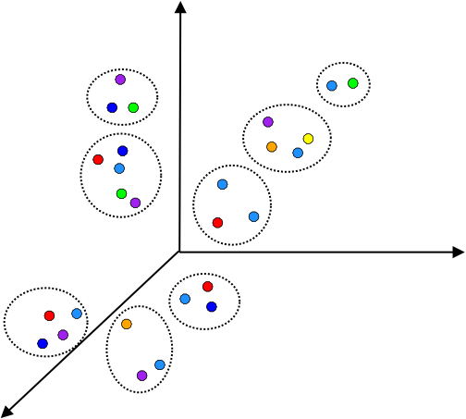
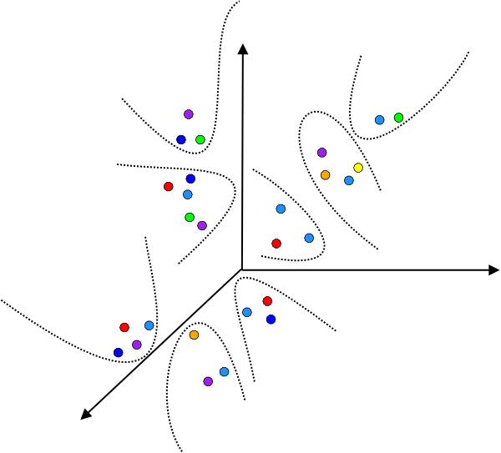
Introduction
Fuzzy Multilevel Graph Embedding
Automatic Indexing of graph repositories
Conclusions and future research challenges
o o o
47
Subgraph spotting through explicit GEM
Unsupervised indexing phase
Graph retrieval and subgraph spotting phase
INDEX
FSMFV clusters using an
hierarchical clustering technique
Classifier

Slide 48
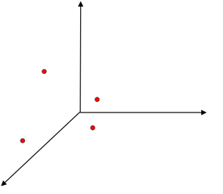
Introduction
Fuzzy Multilevel Graph Embedding
Automatic Indexing of graph repositories
Conclusions and future research challenges
o o o
48
Subgraph spotting through explicit GEM
Unsupervised indexing phase
Graph retrieval and subgraph spotting phase
φ
Resemblance attributes
Cliques of order-2
FSMFVs

Slide 49
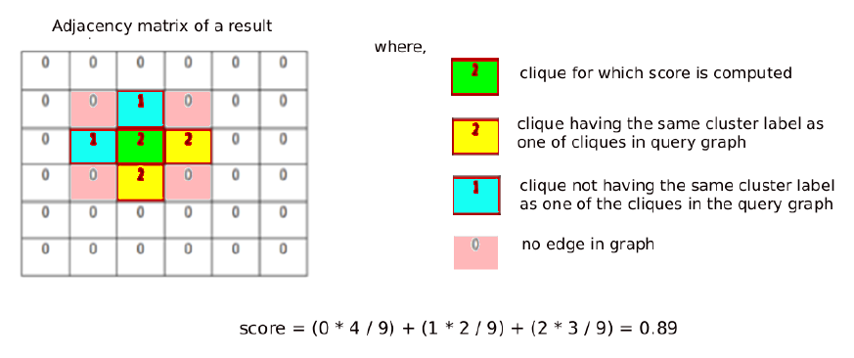
Introduction
Fuzzy Multilevel Graph Embedding
Automatic Indexing of graph repositories
Conclusions and future research challenges
o o o
49
Subgraph spotting through explicit GEM
Unsupervised indexing phase
Graph retrieval and subgraph spotting phase
INDEX
Set of result graphs
z is a value in adjacency matrix (either 0, 1, 2)
|z| is frequency of value z in neighborhood
and
w is number of connected neighbors looked-up
Classify

Slide 50
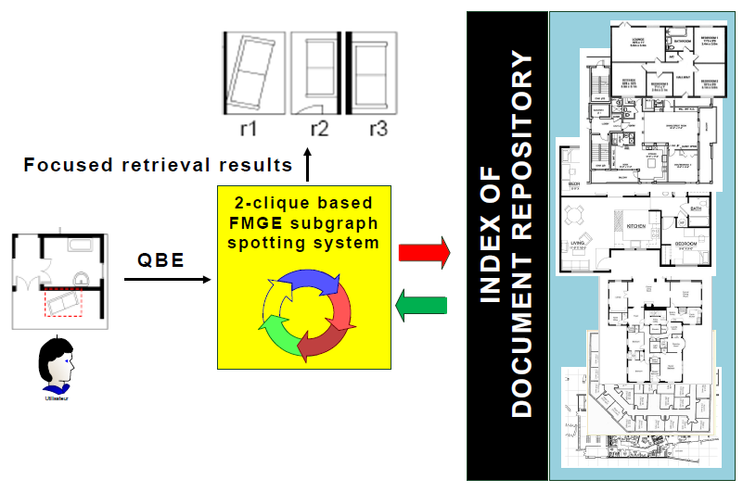
Introduction
Fuzzy Multilevel Graph Embedding
Automatic Indexing of graph repositories
Conclusions and future research challenges
o o o
50
Content spotting in document images

Slide 51
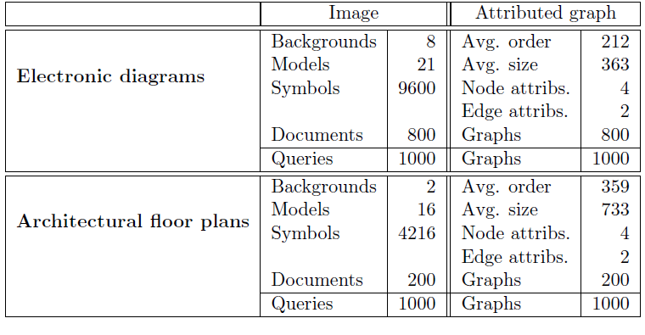
Introduction
Fuzzy Multilevel Graph Embedding
Automatic Indexing of graph repositories
Conclusions and future research challenges
o o o
51
Experimental evaluation
SESYD dataset
Corresponding graph dataset is made publically available
http://www.rfai.li.univ-tours.fr/PagesPerso/mmluqman/public/SESYD_graphs.zip

Slide 52
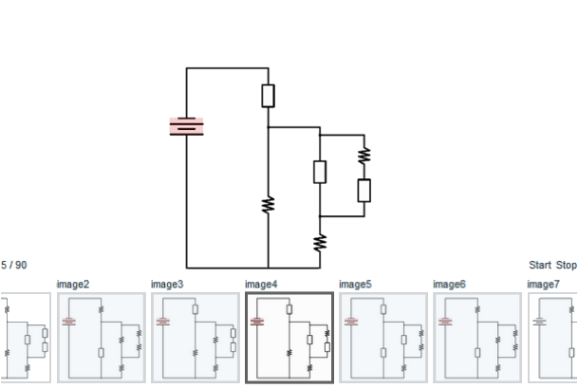
Introduction
Fuzzy Multilevel Graph Embedding
Automatic Indexing of graph repositories
Conclusions and future research challenges
o o o
52
Experimental evaluation

Slide 53
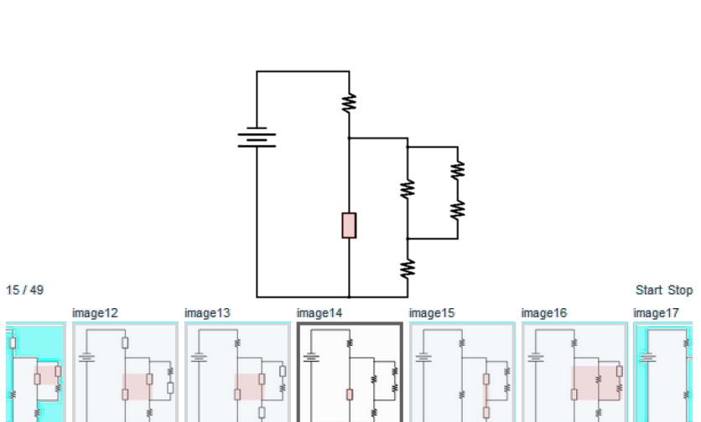
Introduction
Fuzzy Multilevel Graph Embedding
Automatic Indexing of graph repositories
Conclusions and future research challenges
o o o
53
Experimental evaluation

Slide 54
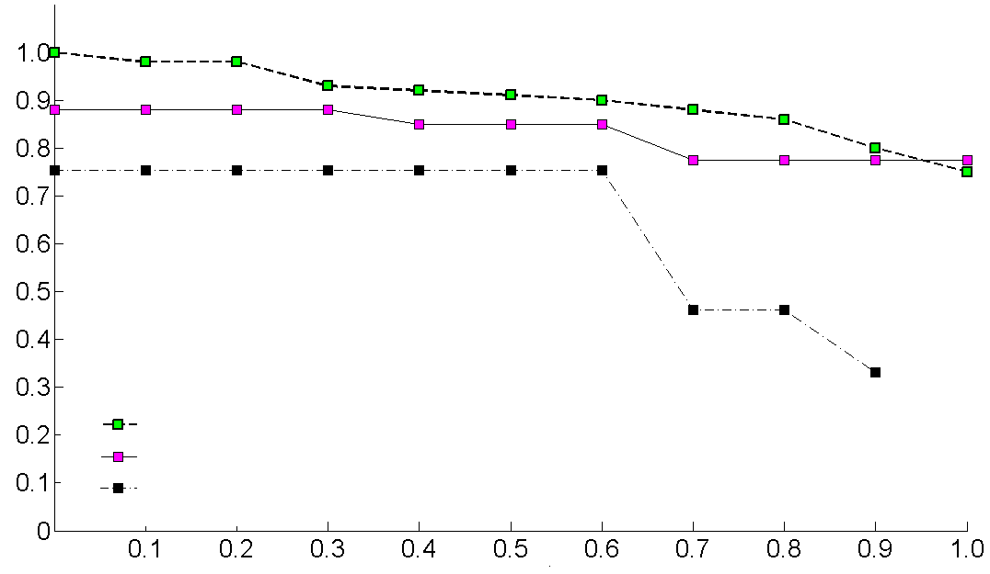
Introduction
Fuzzy Multilevel Graph Embedding
Automatic Indexing of graph repositories
Conclusions and future research challenges
o o o
54
Experimental evaluation
Precision
2-clique based FMGE spotting system
Heuristic based FMGE spotting system [Luqman, 2010]
Heuristic based reference system [Qureshi, 2008]
Recall
Electronic diagrams: (517K 2-node subgraphs) (455 classes) (~17h)

Slide 55
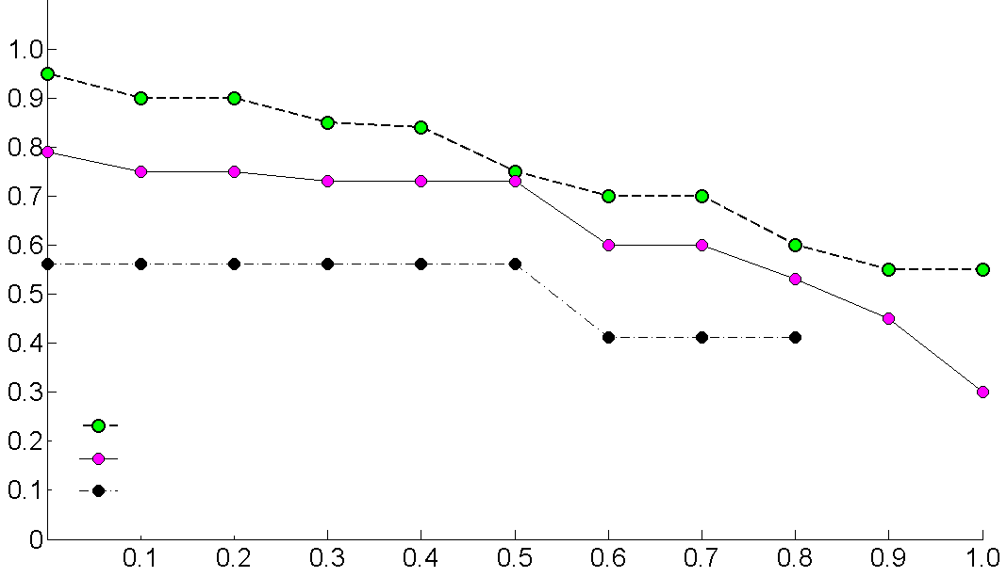
Introduction
Fuzzy Multilevel Graph Embedding
Automatic Indexing of graph repositories
Conclusions and future research challenges
o o o
55
Experimental evaluation
Precision
2-clique based FMGE spotting system
Heuristic based FMGE spotting system [Luqman, 2010]
Heuristic based reference system [Qureshi, 2008]
Recall
Architectural diagrams: (306K 2-node subgraphs) (211 classes)

Slide 56
Introduction
Fuzzy Multilevel Graph Embedding
Automatic Indexing of graph repositories
Conclusions and future research challenges
o o o
56
Discussion – subgraph spotting
Loss of matching between nodes
Score function is a first step forward
No graph embedding based solution to answer high level semantic problems for graphs
FMGE based framework for automatic indexing of graph repositories

Slide 57
57
Conclusions and future challenges
Introduction
Fuzzy Multilevel Graph Embedding (FMGE)
Automatic indexing of graph repositories for graph retrieval and subgraph spotting
Conclusions and future research challenges

Slide 58
Introduction
Fuzzy Multilevel Graph Embedding
Automatic Indexing of graph repositories
Conclusions and future research challenges
o o
58
Conclusions
Last two decade’s research on structural pattern recognition can access state of the art machine learning tools
An impossible operation in original graph space turns into a realizable operation with an acceptable accuracy
Application to domains where the use of graphs is mandatory for representing rich structural and topological information and a computational efficient solution is required
Feature vector not capable of preserving the matching between nodes of a pair of graphs

Slide 59
Introduction
Fuzzy Multilevel Graph Embedding
Automatic Indexing of graph repositories
Conclusions and future research challenges
o o
59
Conclusions
Unsupervised and automatic indexing of graph repositories
Domain independent framework
Incorporating learning abilities to structural representations
Ease of query by example (QBE)
Granularity of focused retrieval

Slide 60
Introduction
Fuzzy Multilevel Graph Embedding
Automatic Indexing of graph repositories
Conclusions and future research challenges
o o
60
Future research challenges
Ongoing and short term
Dimensionality reduction
Feature selection
More topological information
Medium term
Detection of outliers for cleaning learning set
Multi-resolution index using cliques of higher order (≥3)

Slide 61
Introduction
Fuzzy Multilevel Graph Embedding
Automatic Indexing of graph repositories
Conclusions and future research challenges
o o
61
Future research challenges
Long term
Surjective mapping of nodes of two graphs

Slide 62
62
List of publications
Journal paper Pattern Recognition (under review, submitted December 2011) | 1
Book chapter Bayesian Network by InTech publisher | 1
International conference contributions ICDAR 2011, ICPR 2010, ICDAR 2009 | 3
Selected papers for post-workshop LNCS publication ICPR 2010 contests, GREC 2009 | 2
International workshop contributions GREC 2011, GREC 2009 | 2
Francophone conference contributions CIFED 2012, CIFED 2010 | 2

Slide 63
Thank you for your attention.

Slide 64
Cotutelle PhD thesis
Fuzzy Multilevel Graph Embedding for Recognition, Indexing and Retrieval of Graphic Document Images
Directors of thesis
Dr. Jean-Yves RAMEL
Professor
University of Tours, France
Dr. Josep LLADOS
Professor
UAB, Spain
Co-supervisor
Dr. Thierry BROUARD
Assistant Professor
University of Tours, France
presented by
Muhammad Muzzamil LUQMAN
mluqman@{univ-tours.fr, cvc.uab.es}
Friday, 2nd of March 2012

